Slide 1
Cookbook for Practice 4.3
实践4.3攻略
Cong Li 李聪

Slide 2
Look at the Data First 先看数据
…
====================================== [ finmeccanica/NP ] is/VBZ [ an/DT italian/JJ state-owned/JJ holding/VBG company/NN ] with/IN [ interests_5/NNS ] in/IN [ the/DT mechanical/JJ engineering/NN industry/NN ] ./.
$$
…
Garbage characters
垃圾字符
Base noun phrase tags which we do not use 基本名词短语标记，我们不用
Skip the next line
跳过后面一行

Slide 3
Look at the Data First 先看数据
…
====================================== [ finmeccanica/NP ] is/VBZ [ an/DT italian/JJ state-owned/JJ holding/VBG company/NN ] with/IN [ interests_5/NNS ] in/IN [ the/DT mechanical/JJ engineering/NN industry/NN ] ./.
$$
…
Label format: ‘_’ after ‘interest(s)’, then the class label
标注格式：“interest(s)”后面跟随“_”，然后是类别标记

Slide 4
Regular Expression 正则表达式(1)
Start a new file ‘interestData.py’ w/ a new class
创建一个包含新的类型的新文件“interestData.py”
Import ‘re’ for regular expression processing
导入“re”处理正则表达式
In a regular expression, ‘?’ represents the preceding character can be either absent or present, & ‘\d’ represent a digit from 0~9
在一个正则表达式中，“?”表示前一个字符可有可无，“\d”表示一个0~9之间的数字
Example: 示例： ‘interests?_\d’
‘s’ either present or absent
“s”可有可无

Slide 5
Regular Expression 正则表达式(1)
Start a new file ‘interestData.py’ w/ a new class
创建一个包含新的类型的新文件“interestData.py”
Import ‘re’ for regular expression processing
导入“re”处理正则表达式
In a regular expression, ‘?’ represents the preceding character can be either absent or present, & ‘\d’ represent a digit from 0~9
在一个正则表达式中，“?”表示前一个字符可有可无，“\d”表示一个0~9之间的数字
Example: 示例： ‘interests?_\d’
Single digit 单个数字

Slide 6
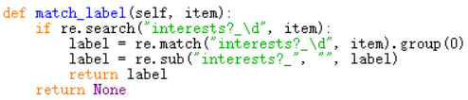
Regular Expression 正则表达式(2)
Add a member function ‘match_label’ to extract the label from an ‘interest’ word item, but return None if it is not
添加一个成员函数“match_label”，从一个“interest”词项中抽取出类别标记，否则返回None
Match w/ the regular expression 用该正则表达式匹配
Extract the first match
抽取出第一个匹配的字符串

Slide 7
Regular Expression 正则表达式(2)
Add a member function ‘match_label’ to extract the label from an ‘interest’ word item, but return None if it is not
添加一个成员函数“match_label”，从一个“interest”词项中抽取出类别标记，否则返回None
Use substitution (deletion) to extract the single digit
用替换（删除）的方式抽取出单个数字

Slide 8
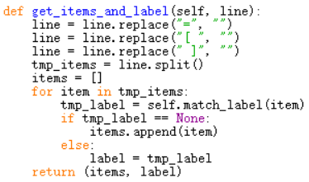
Process a Line 处理一行
Add a member function ‘get_items_and_label’ taking a line as the input & returning the context word items & the class label
添加一个成员函数“get_items_and_label”，输入一行，输出上下文词项和类别标记
Use replacement to delete useless characters 用替换来删除无用的字符

Slide 9
Process a Line 处理一行
Add a member function ‘get_items_and_label’ taking a line as the input & returning the context word items & the class label
添加一个成员函数“get_items_and_label”，输入一行，输出上下文词项和类别标记
If an item does not contain the class label, then put it into context word items, otherwise extract the label 如果某一项不包含类别标记，则加入上下文词项，否则抽取标记

Slide 10


Build the Dictionary 创建字典 (1)
Add a member function ‘build_dict’ to build the dictionary from a file & start w/ a member variable of dictionary type
添加一个成员函数“build_dict”，从一个文件中创建字典，开始时声明一个字典类型的成员变量
Variables of dictionary type can be accessed w/ array-style syntax, e.g., 字典类型的变量可以用数组形式的方式访问，例如

Slide 11
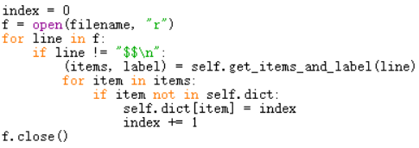
Build the Dictionary 创建字典 (2)
Read lines from the file & create the context word dictionary
从文件中读取每一行，创建上下文单词的字典
Filter irrelevant lines
过滤无关行
Add index entry for a new context word item
为新上下文单词添加下标索引

Slide 12
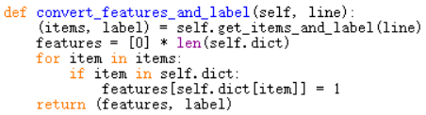
Convert the Line 变换一行
Add a member function ‘convert_features_and_label’ to convert a line to attributes (features) & class label
添加一个成员函数“convert_features_and_label”，把一行变成属性（特征）和类别标记
Check the dictionary to retrieve the corresponding index
从字典中找到对应的下标

Slide 13
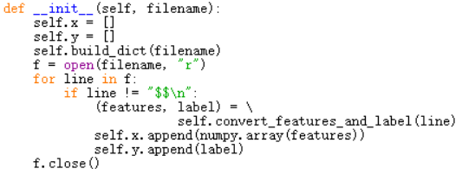
Processing File 处理文件
Import ‘numpy’ 导入“numpy”
Read the file in the initialization function of the class & store the data in 2 member variables
在该类型的初始化函数中读取文件，把数据存入两个成员变量中

Slide 14

Return Data 返回数据
Add a member function ‘get_data’ to allow data retrieval
添加一个成员函数“get_data”，以便获取数据

Slide 15


Main Program 主程序 (1)
Import the relevant components
导入相关组件
Start the main section from reading the data from file
在main部分，从文件中读取数据

Slide 16
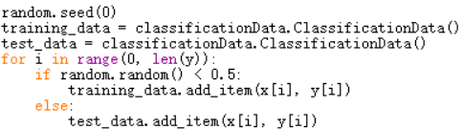

Main Program 主程序 (2)
Randomly split the data for training & testing
随机切分数据，用作训练和评估
Perform nearest neighbor classification
进行最近邻分类
Does it perform well? 表现如何？

Slide 17
The End

